Slide 1
Social Media Data: How to Get It and What You Need to Know
Jessica Pater, PhD
Mirro Center for Research and Innovation, Parkview Health
www.jesspater.com
@jesspater

Slide 2
Follow Along!
Slides available at:
www.jesspater.com/publications
Lots of embedded links to additional resources and to specific sites we are going to talk about!

Slide 3
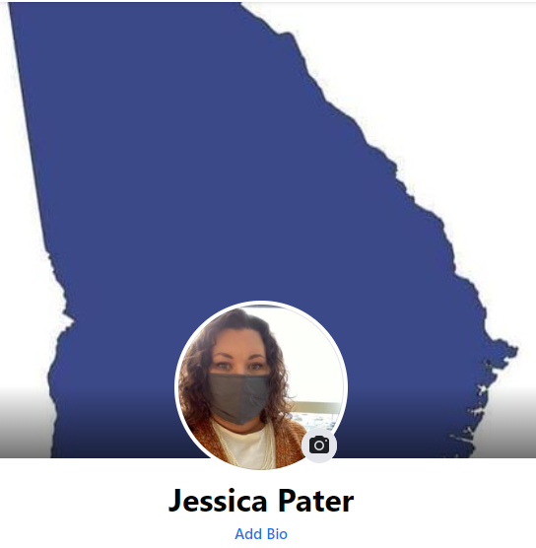
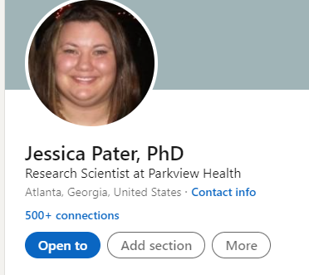
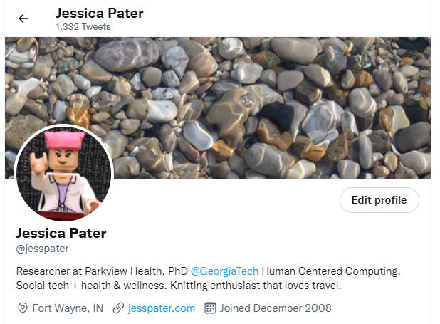
Who am I?

Slide 4
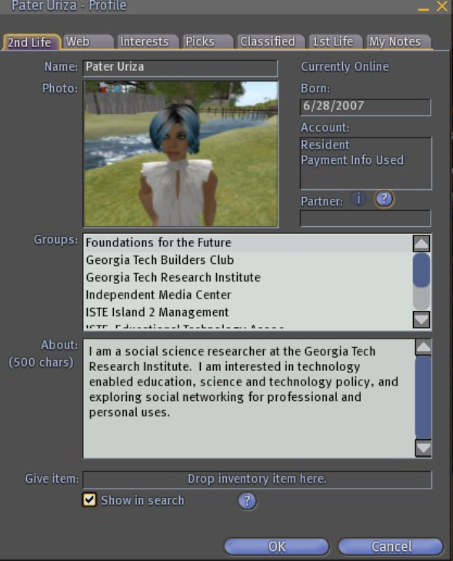
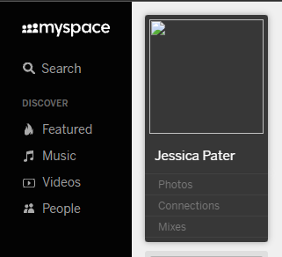

Slide 5
Why would you want to use social media in your research?

Slide 7
Social Media platform community & technical affordances
Social media content

Slide 8
Understanding Scope: Platforms

Slide 9
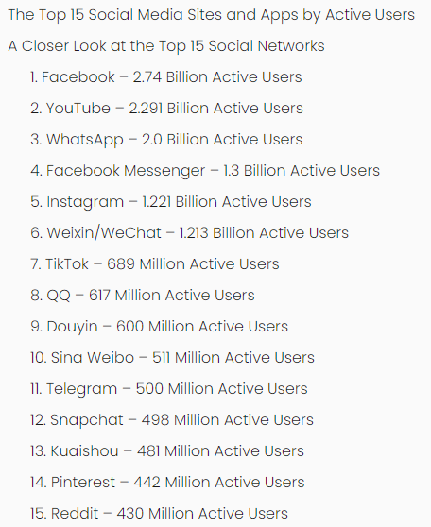
What culture are you wanting to study?
How do policies shape the interaction in that online space? Does that matter?

Slide 10
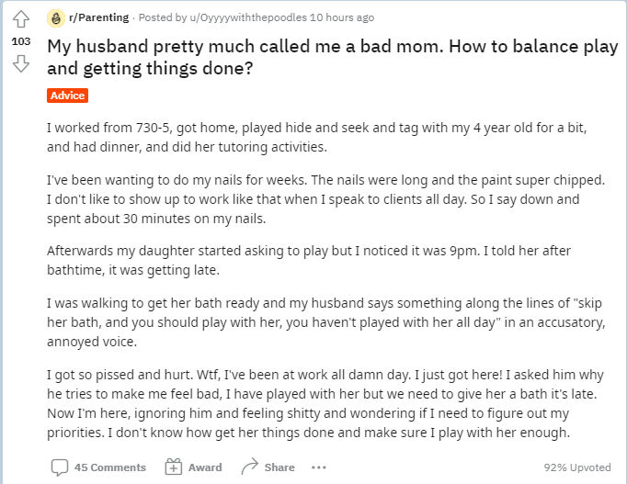
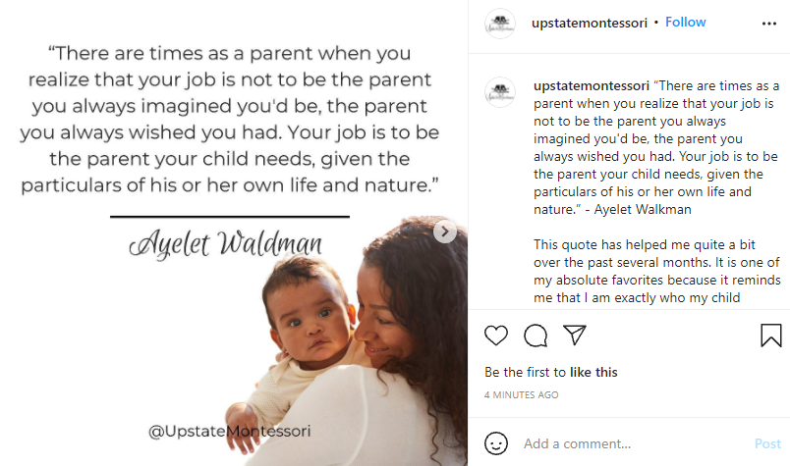

Slide 11
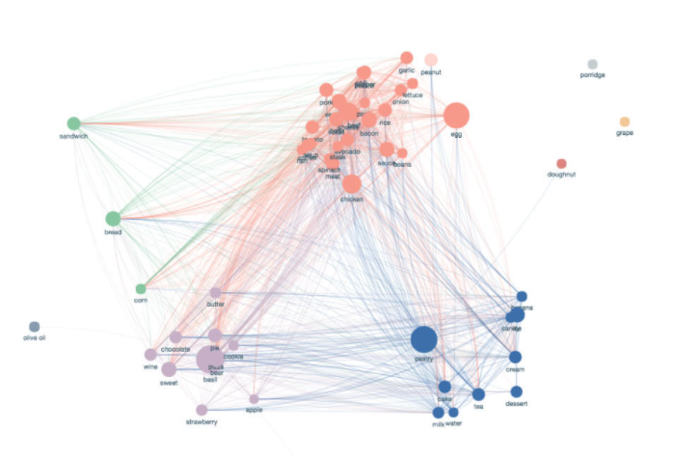
Understanding Scope: Audience

Slide 12
Who is your community?
Entire Platform
Concept (e.g. Hashtag)
Group/Page
Individual

Slide 13
Who is your community?
…..
Concept (e.g. Hashtag)
……
…..
…..
Concept (e.g. Hashtag)
……
…..
…..
Concept (e.g. Hashtag)
……
…..

Slide 14
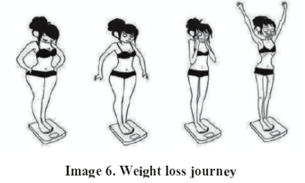
Why I use social media in my research
Connect digital traces mental health traces to physical health and well-being
Characterization: How do people talk about eating disorders on social media?
Correlation: What is the impact of social media on a person’s health? How do we qualify and quantify that?
Causation: Do specific eating-disorder related online behaviors contribute to the start or exacerbation of eating disorder symptoms?

Slide 15
Where would you start in planning your integration of social media data into your research?

Slide 16
Organizing your plan of attack
Why
Research questions/aims
Where
Platform selection
Who
Individual, group
What
Group/page, individual concept/#<insert>
When
Date range

Slide 17
How do we “get” data?
Buying/Dowloading it
Asking users to share
Platform API
“scraping”
Computationally
By hand

Slide 18
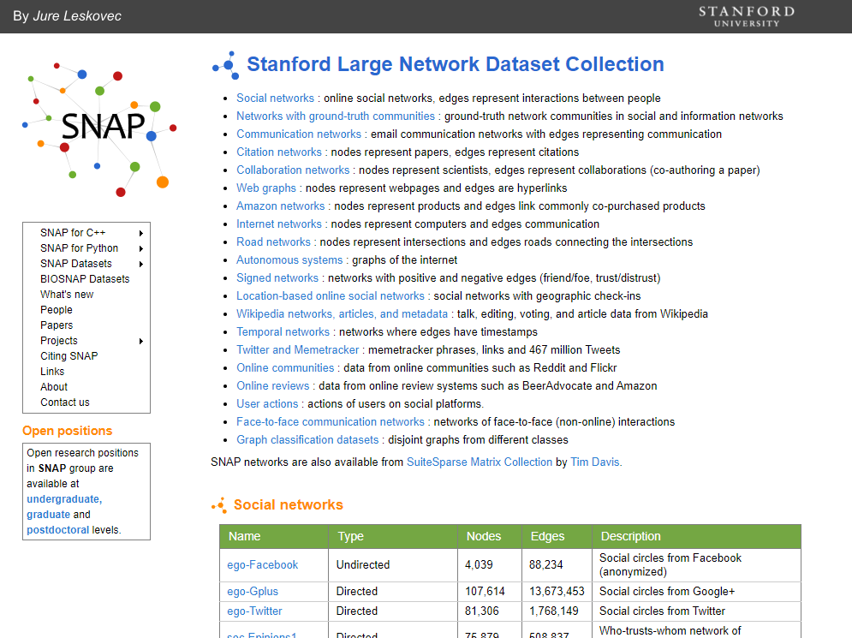
Buying/Downloading Data

Slide 19
Benefits?
Challenges?

Slide 20
Benefits?
Quick
No need for technical proficiency to collect
De-identified
Comparisons to others who have used the dataset
Challenges?
$$$$
No control over dataset inputs
Unable to update/modify

Slide 21
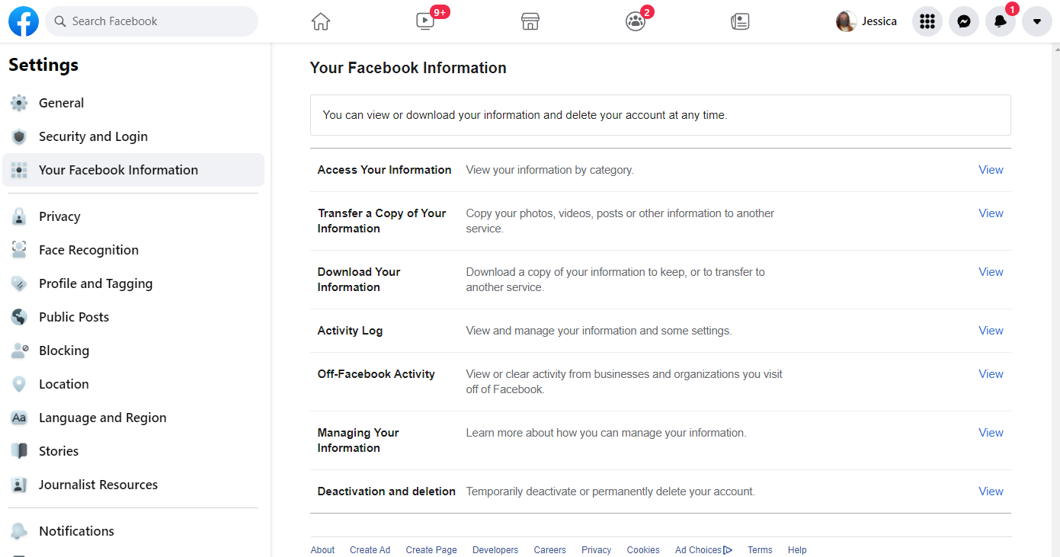
Asking people to share their data

Slide 22
Benefits?
Challenges?

Slide 23
Benefits?
Complete user’s journey
Customizable downloads (dependent on platform)
Gets around lack of API
One of the only ways to get complete data if account is private
Challenges?
Getting people to download/share
Privacy
De-identification nightmare

Slide 24
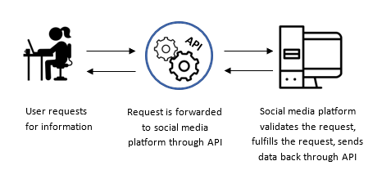
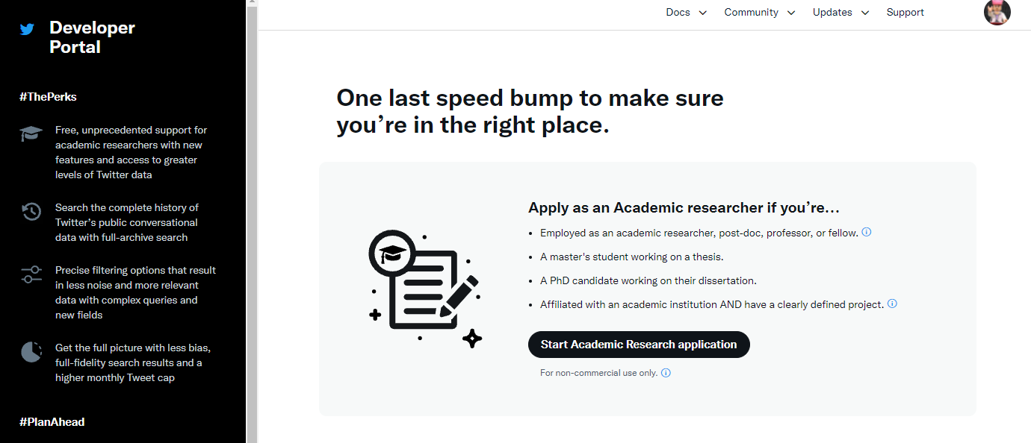
Platform API
An application programming interface or API is a set of protocols and tools that allow for a clearly defined communication protocol between various software components.
Must register with the platform

Slide 25
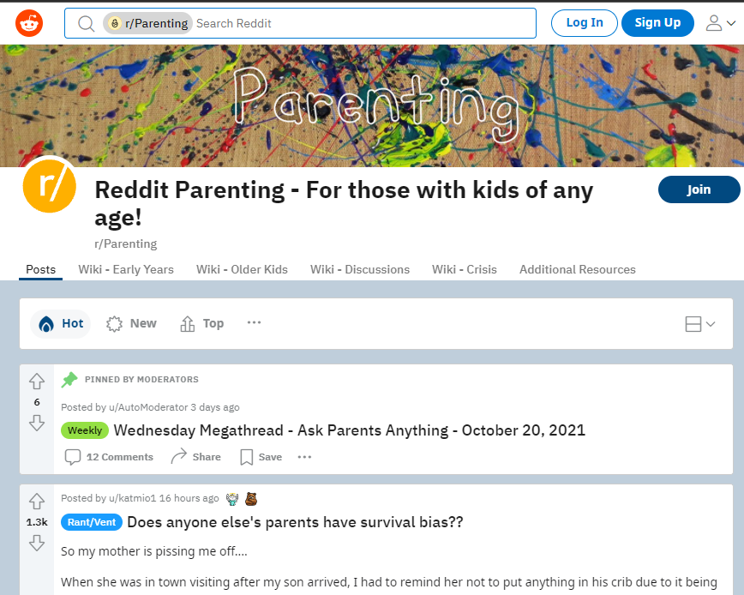
Example: r/parenting

Slide 26
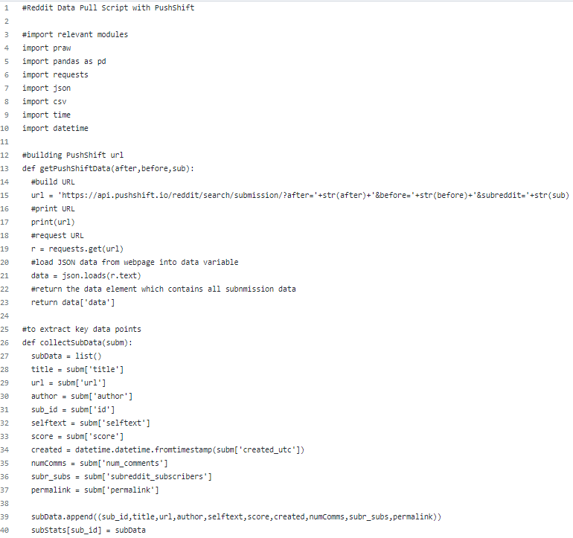
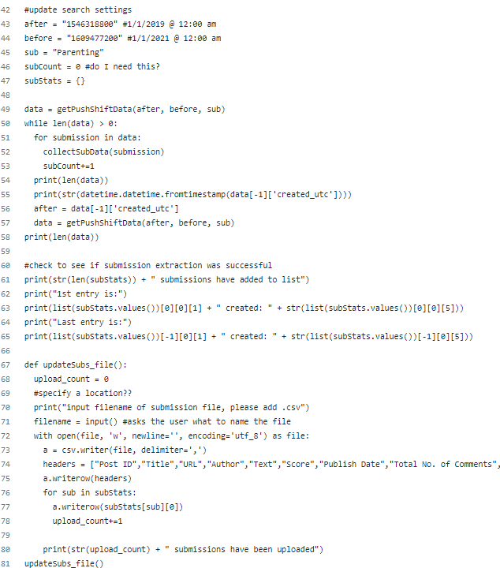
The Code
Notes:
PRAW: is designed to follow all of reddit’s API rules. You have to give a useragent that follows the rules, everything else is handled by PRAW so you needn’t worry about violating them.
PANDAS: toolket that allows for data analysis within PYTHON
Requests allows you to send HTTP/1.1 requests extremely easily
JSON: used to store and communicate information to other product

Slide 27
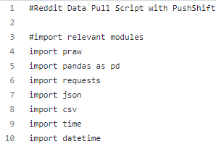
The Code
Imports
PRAW: Python Reddit API Wrapper
PANDAS: Python-based data analysis
Requests
JSON: JavaScript Object Notation
Notes:
PRAW: is designed to follow all of reddit’s API rules. You have to give a useragent that follows the rules, everything else is handled by PRAW so you needn’t worry about violating them.
PANDAS: toolket that allows for data analysis within PYTHON
Requests allows you to send HTTP/1.1 requests extremely easily
JSON: used to store and communicate information to other product

Slide 28
The Code
Accessing the API
Notes:
The pushshift.io Reddit API was designed and created by the /r/datasets mod team to help provide enhanced functionality and search capabilities for searching Reddit comments and submissions.

Slide 29
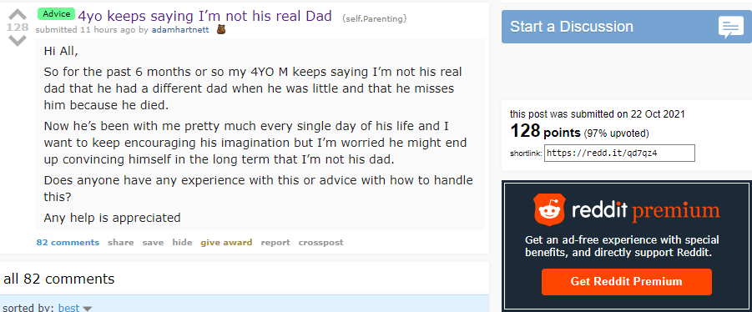
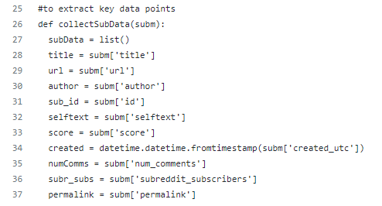
The Code
Defining what you want pulled

Slide 30
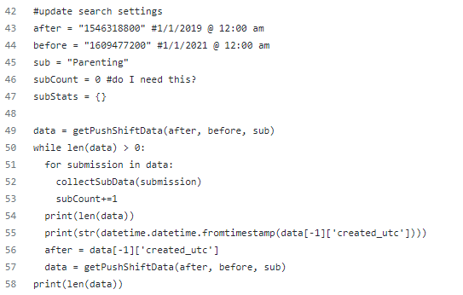
The Code
Search parameters

Slide 31
The Code
Check to see if pull was successful

Slide 32
The Code
Writing to a file

Slide 33
Benefits?
Challenges?

Slide 34
Benefits?
Preferred method from Platform perspective
Access metadata (depends on platform)
Download large amounts of data
Challenges?
Technical proficiency
Constant updates to what API allows for (and doesn’t)
Limited to public data

Slide 35
“Scrapping” Data
Building a web scraper (Computational)
A tool that goes through and automatically captures data from the “screen” of the social media platform based on specific search criteria
Gather text, images, or videos
Manual (By-hand)
Individuals logging into the platform with a valid account and collecting data manually based on specific search criteria.

Slide 36
Benefits?
Challenges?

Slide 37
Benefits?
Quick (Computational)
Automated (Computational)
Within scope of most Terms of Service (By-hand)
Challenges?
Slow (By-hand)
Goes against most Terms of Service (Computational)
Limited to public data (Both)

Slide 38
Strategies for implementation
Computer Science/Info Sci undergraduates!
Online Training
Social Media Data Analytics (Univ of Washington)
The Data Scientists Tool Box (Johns Hopkins Univ.)
Introduction to Social Media Analytics (Emory Univ.)

Slide 39
What are the ethical considerations of using social media data in research?

Slide 40
Ethical Considerations
Legal/Policy
Balancing out the potential harm
Does public = publishable?
What does it mean if someone can infer that someone’s data is being used in my work?
Fluidity of social norms

